Slide 1
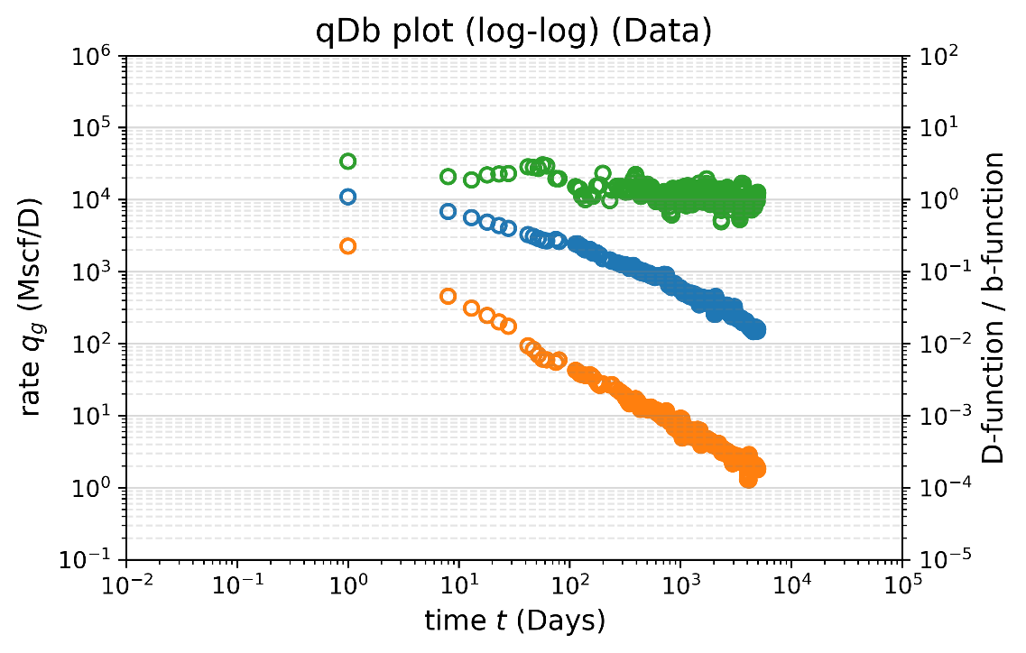
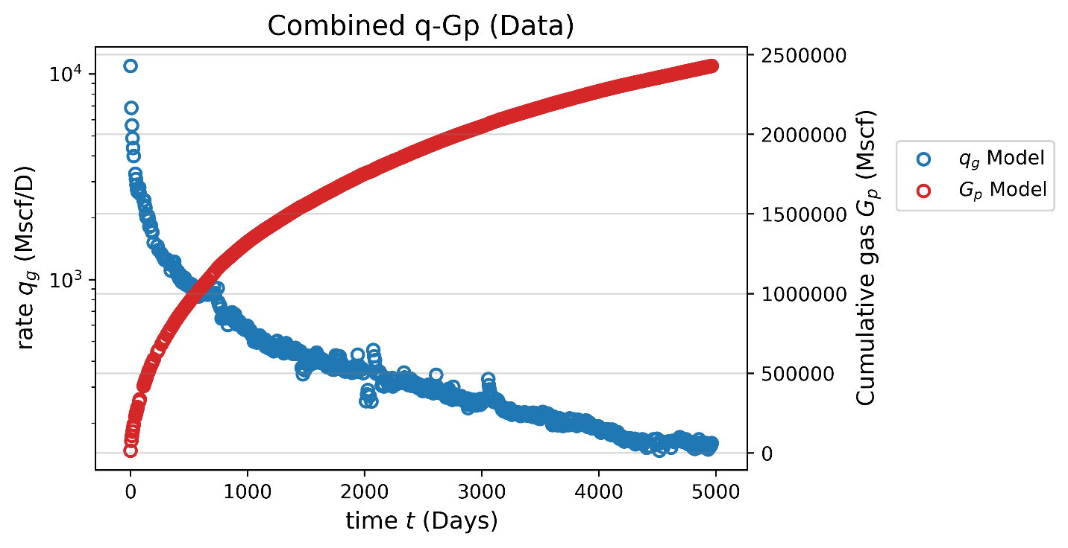

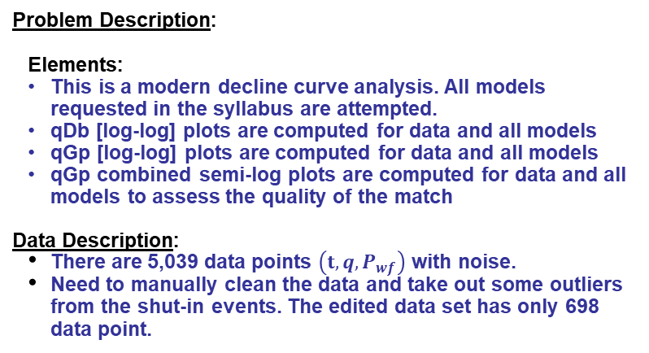
Problem Description/Data/Reference: Final Project (DCA) - SPE 114947 (Ilk)
Problem Description:
Elements:
This is a modern decline curve analysis. All models requested in the syllabus are attempted.
qDb [log-log] plots are computed for data and all models
qGp [log-log] plots are computed for data and all models
qGp combined semi-log plots are computed for data and all models to assess the quality of the match
Data Description:
There are 5,039 data points $\left(t, q,P_{wf}\right)$ with noise.
Need to manually clean the data and take out some outliers from the shut-in events. The edited data set has only 698 data point.
Challenges:
Because the matching algorithm is programmed in Python module. I need to compute D and b functions analytically for all models.
Need to remove some noise before calculating D and b functions because they are the point-to-point derivatives from the production data
Cumulative gas production at 30 years from all models will be compared.
Results from publication/reference:
The time-rate-for the entire history is given
b and D functions (with smoothing) are provided.
Reference:
Ilk, D., Perego, A. D., Rushing, J. A., and Blasingame, T. A. (2008) Integrating Multiple Production Analysis Techniques to Assess Tight Gas Sand Reserves: Defining a New Paradigm for Industry Best Practices. Society of Petroleum Engineers. doi:10.2118/114947-MS

Slide 2
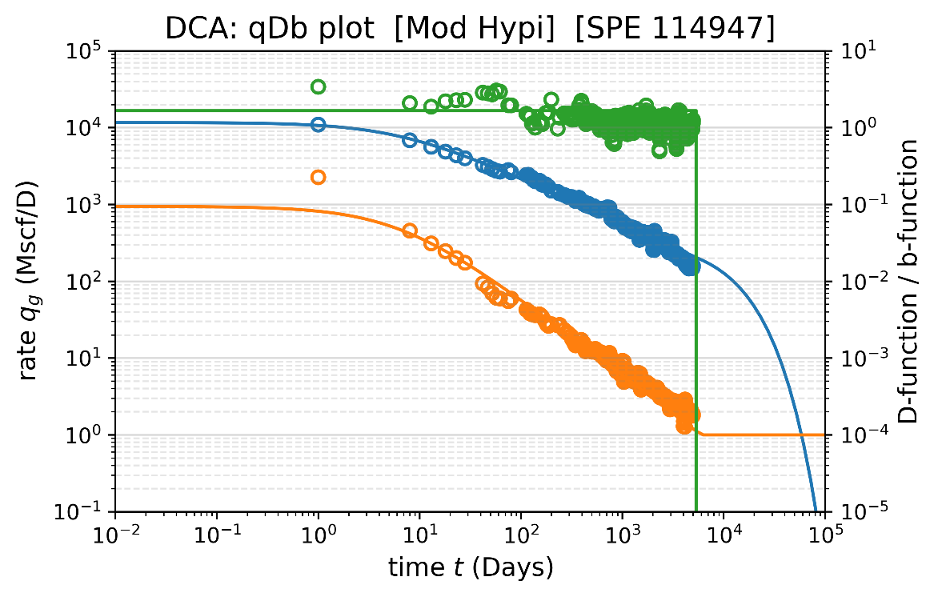
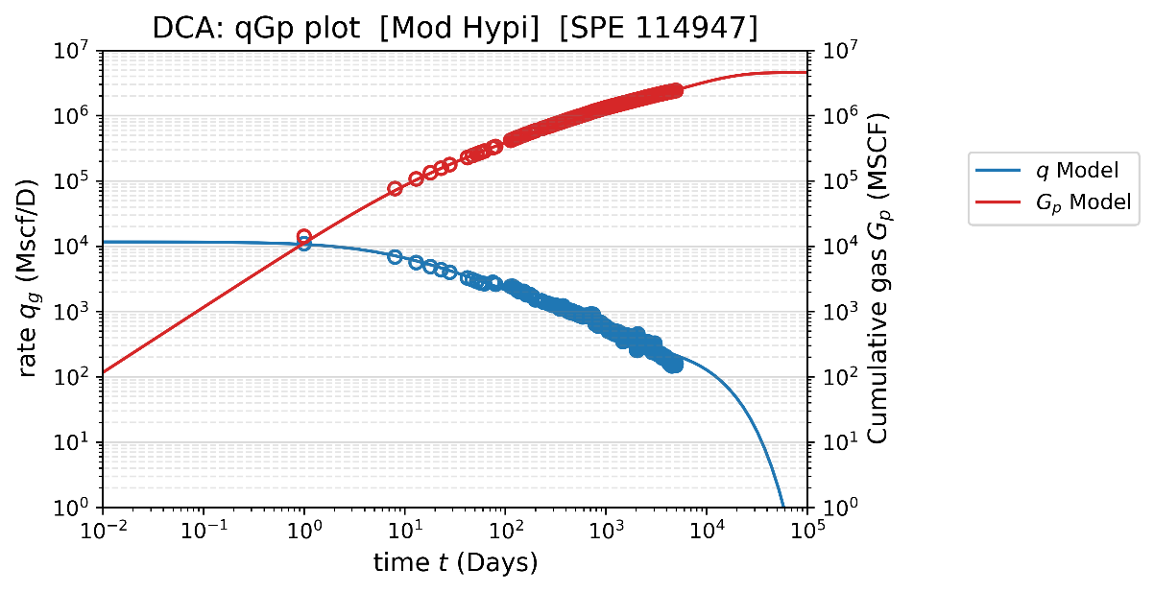
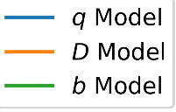
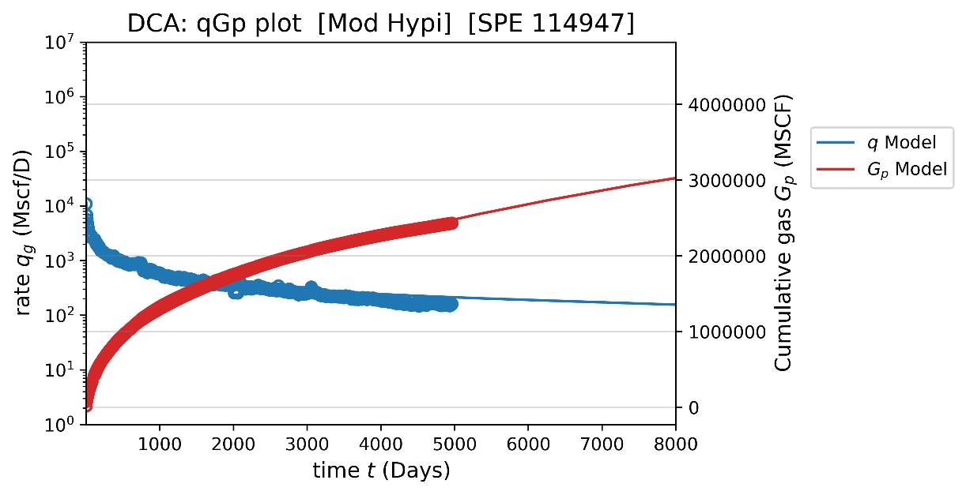
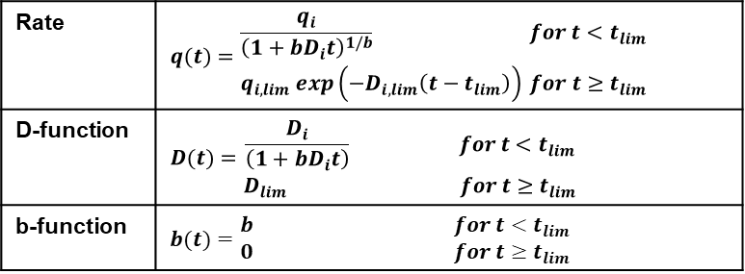
DCA model: Modified Hyperbolic (SPE 119369)
Equation box:
Parameters to be Solved: (Final Estimates)
(from Python Program)
INITIAL RATE (qi), MSCF/D = 11677
Di-CONSTANT (Di), 1/Day = 0.09456
b-CONSTANT (b), Dim-less = 1.6657
LIMIT Di (Di-limit), 1/Day = 1.0E-4 (*)
CUM. GAS @ 30 YRS (Gp), BSCF = 3.416
(*) Switch to exponential decline
Rate | $$q(t)=\begin{matrix}\frac{q_{i}}{{\left(1+bD_{i}t\right)}^{1/b}} for t<t_{lim} \\ q_{i,lim} exp\left(−D_{i,lim}\left(t−t_{lim}\right)\right) for t≥t_{lim}\end{matrix}$$
D-function | $$D(t)=\begin{matrix}\frac{D_{i}}{\left(1+bD_{i}t\right)} for t<t_{lim} \\ D_{lim} for t≥t_{lim}\end{matrix}$$
b-function | $$b(t)=\begin{matrix}b for t<t_{lim} \\ 0 for t≥t_{lim}\end{matrix}$$
Comment:
I applied the terminal decline rate, so the hyperbolic decline will be switched to the exponential decline.
B-function is not as constant as imposed by hyperbolic model. But the approximation is OK.
Hyperbolic model misses the decline rate (D) toward the early time
Hyperbolic decline is more optimistic compared to the other methods (3.42 BSCF is quite high)

Slide 3
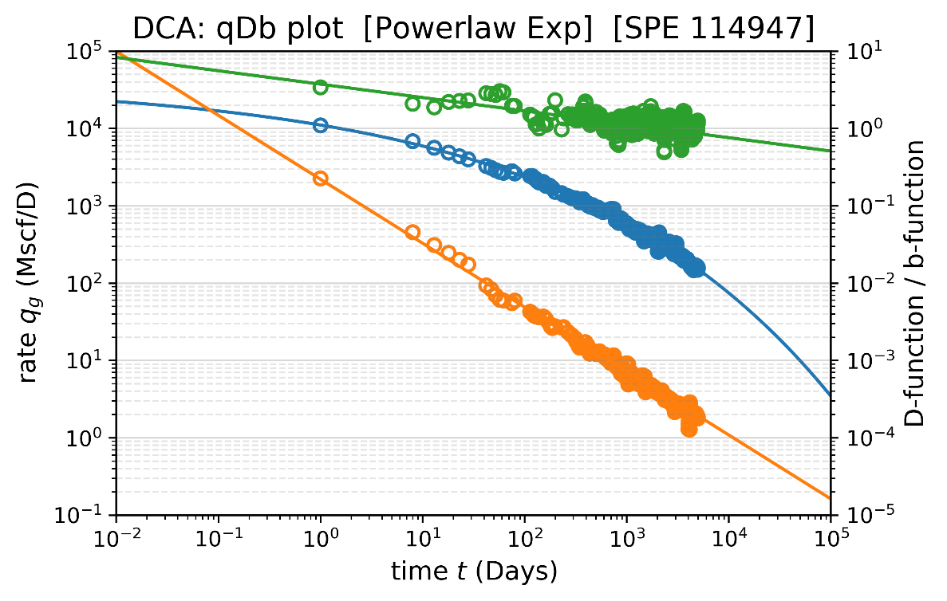
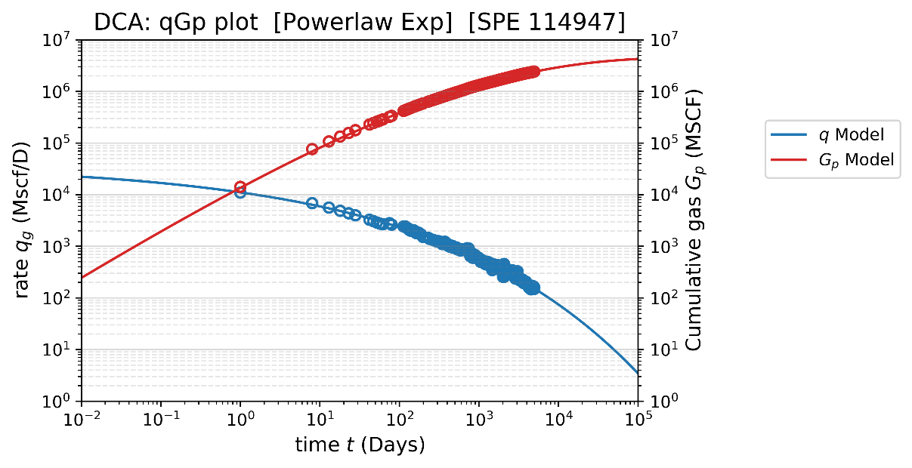
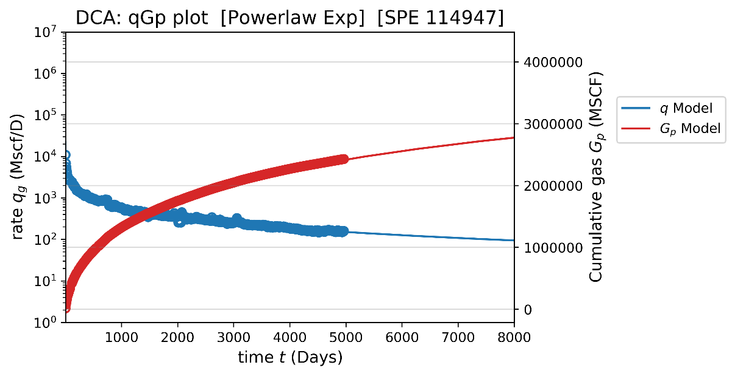
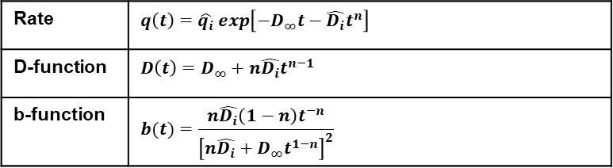
DCA model: Power-law Exponential (SPE 116731)
Equation box:
Parameters to be Solved: (Final Estimates)
(from Python Program)
INITIAL RATE (qi), MSCF/D = 39693
Di-CONSTANT (Di), Vary = 1.27511
n-CONSTANT (n), constant = 0.17306
Di-infinity (Di-inf), 1/Day = 0
CUM. GAS @ 30 YRS (Gp), BSCF = 3.005
Rate | $$q\left(t\right)=\hat{q_{i}} exp\left[−D_{∞}t−\hat{D_{i}}t^{n}\right]$$
D-function | $$D\left(t\right)=D_{∞}+n\hat{D_{i}}t^{n−1}$$
b-function | $$b(t)=\frac{n\hat{D_{i}}\left(1−n\right)t^{−n}}{{\left[n\hat{D_{i}}+D_{∞}t^{1−n}\right]}^{2}}$$
Comment:
This model fits extremely well with q, D-function and b-function compared to the other models.
Power-law exponential provides more conservative cumulative production (3.01 BSCF) than modified hyperbolic (3.42 BSCF) but more optimistic than logistic (2.82 BSCF) and Weibull (2.65 BSCF)

Slide 4
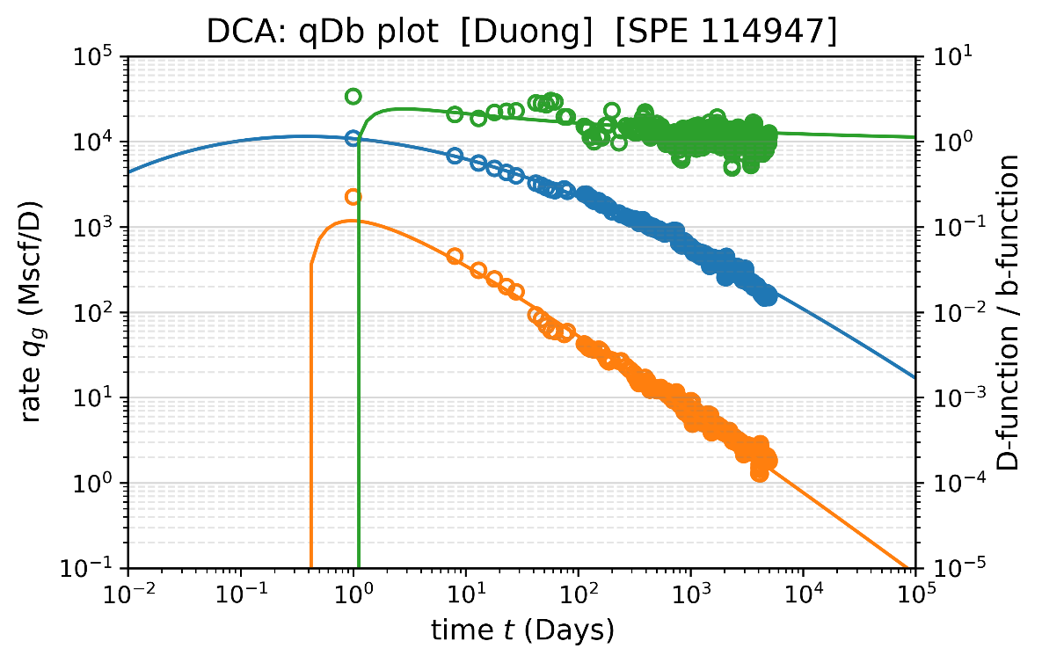
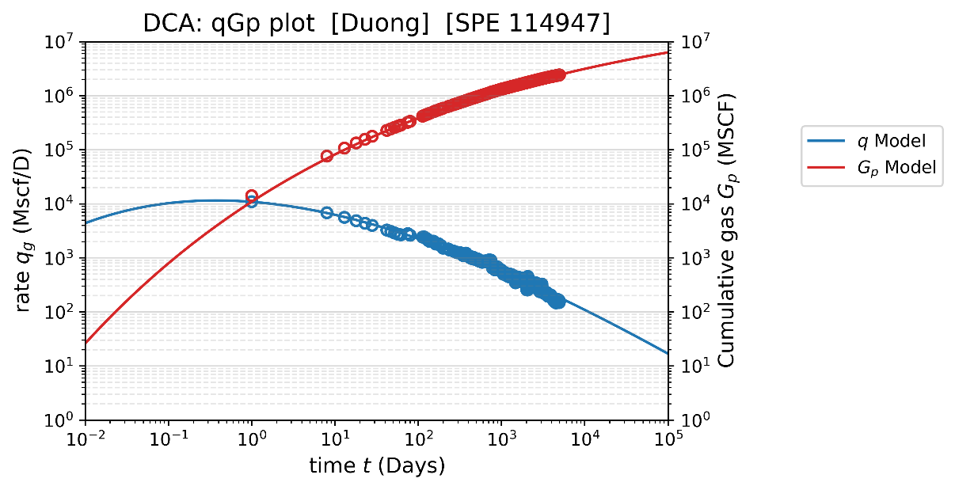
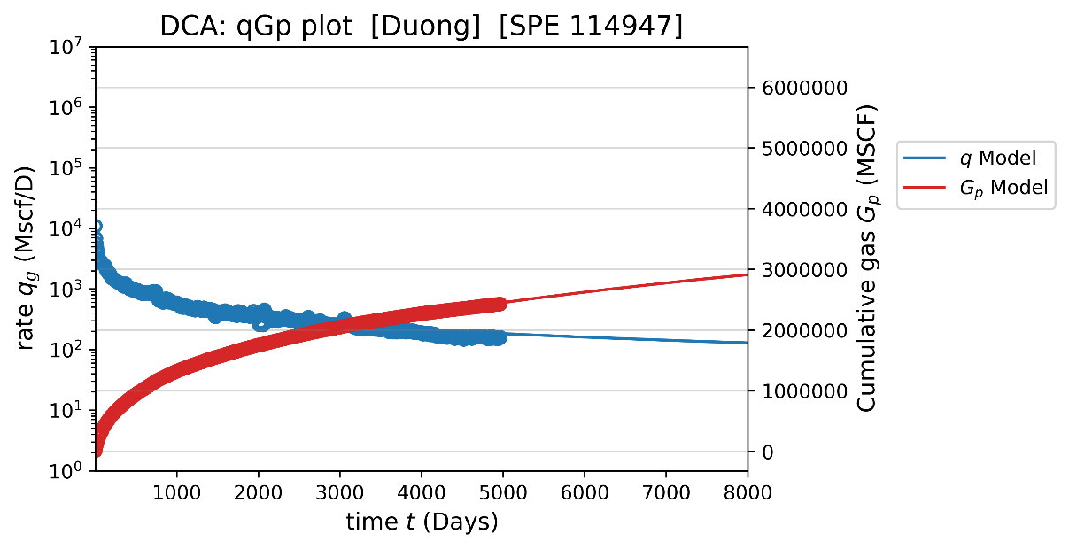
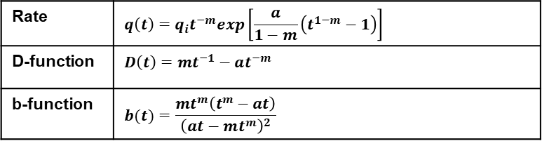
DCA model: Duong’s model (SPE 137748)
Equation box:
Parameters to be Solved: (Final Estimates)
(from Python Program)
INITIAL RATE (qi), MSCF/D = 10895
a-CONSTANT (a), constant = 0.99596
m-CONSTANT (m), constant = 1.1147
CUM. GAS @ 30 YRS (Gp), BSCF = 3.241
Rate | $$q\left(t\right)=q_{i}t^{−m}exp\left[\frac{a}{1−m}\left(t^{1−m}−1\right)\right]$$
D-function | $$D\left(t\right)=mt^{−1}−at^{−m}$$
b-function | $$b(t)=\frac{mt^{m}\left(t^{m}−at\right)}{{\left(at−mt^{m}\right)}^{2}}$$
Comment:
This model has some peculiar behaviors at the early time. However, it is a model artifact that will not be used for reserve prediction in the future
Duong’s model assumes power law relation between q/Gp ratio and time. It tends to give more optimistic cumulative production compared to other models. (3.24 BSCF in Duong is higher than 3.01 BSCF in Power-law exponential and 2.82 BSCF in logistic model)

Slide 5
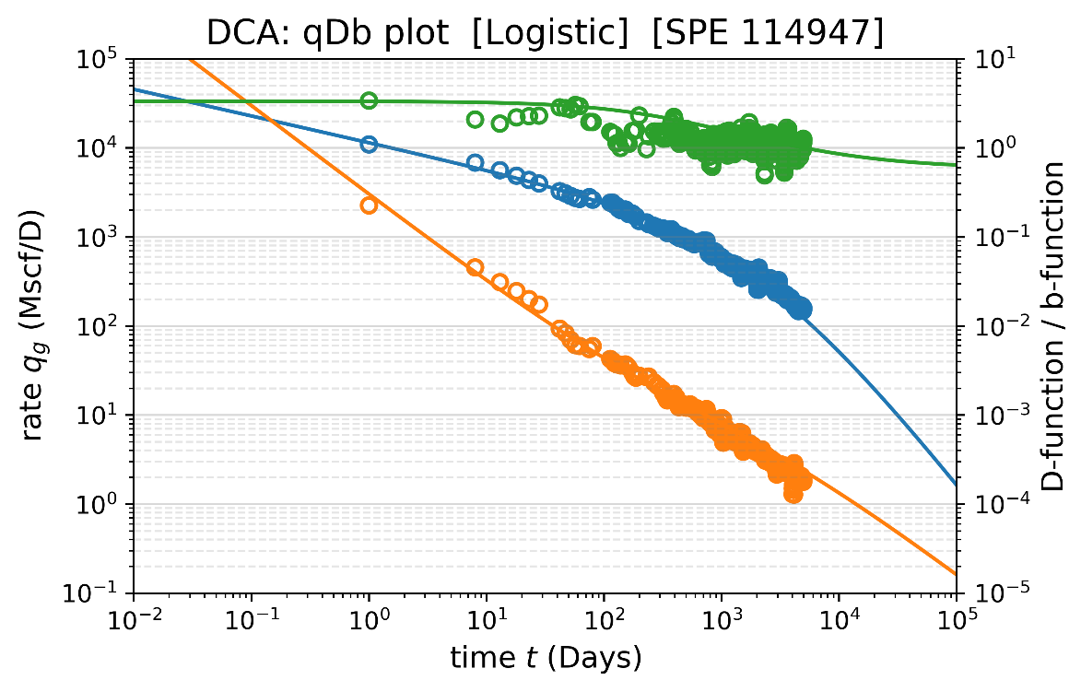
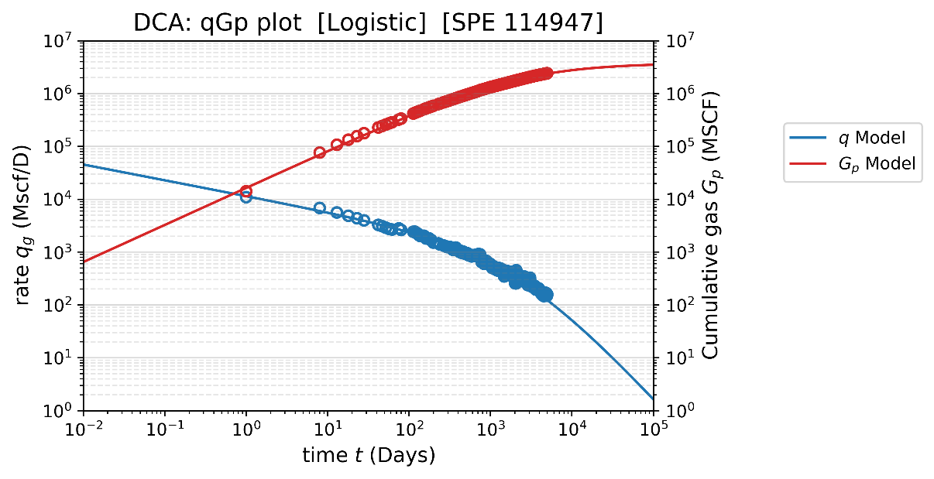
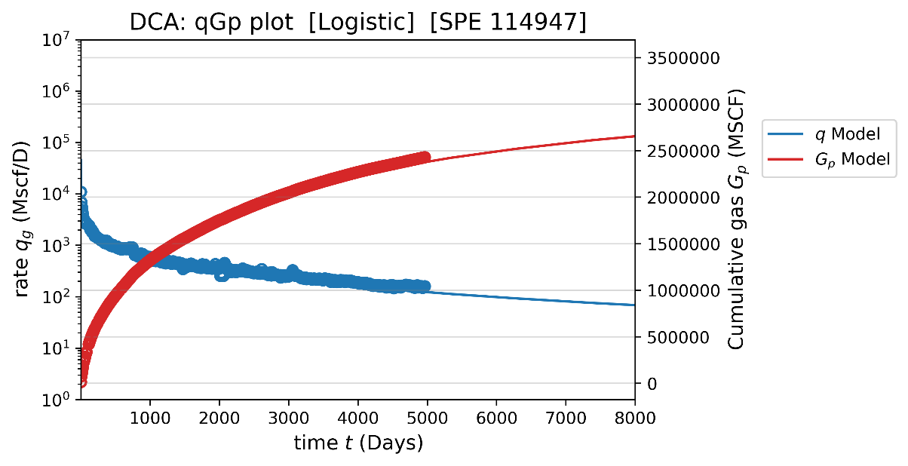
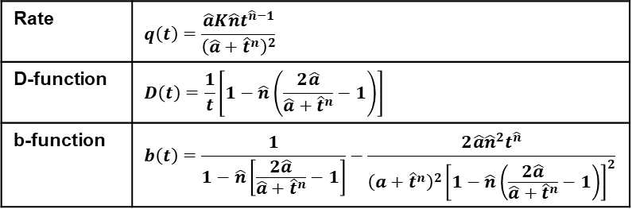
DCA model: Logistic model (SPE 144790)
Equation box:
Parameters to be Solved: (Final Estimates)
(from Python Program)
a-CONSTANT (a), constant = 229.06
n-CONSTANT (n), constant = 0.70196
K-CONSTANT (n), MSCF = 3.7659E+6
CUM. GAS @ 30 YRS (Gp), BSCF = 2.817
Rate | $$q\left(t\right)=\frac{\hat{a}K\hat{n}t^{\hat{n}−1}}{{\left(\hat{a}+{\hat{t}}^{n}\right)}^{2}}$$
D-function | $$D\left(t\right)=\frac{1}{t}\left[1−\hat{n}\left(\frac{2\hat{a}}{\hat{a}+{\hat{t}}^{n}}−1\right)\right]$$
b-function | $$b\left(t\right)=\frac{1}{1−\hat{n}\left[\frac{2\hat{a}}{\hat{a}+{\hat{t}}^{n}}−1\right]}−\frac{2\hat{a}{\hat{n}}^{2}t^{\hat{n}}}{{\left(a+{\hat{t}}^{n}\right)}^{2}{\left[1−\hat{n}\left(\frac{2\hat{a}}{\hat{a}+{\hat{t}}^{n}}−1\right)\right]}^{2}}$$
Comment:
This model is built on the logistic growth model and carrying capacity (K).
The logistic growth model does not extrapolate to non-physical values.
The cumulative production from this model is more conservative (2.82 BSCF) than the other methods. (e.g. Duong = 3.24 BSCF, Power-law Exp. = 3.01 BSCF)

Slide 6
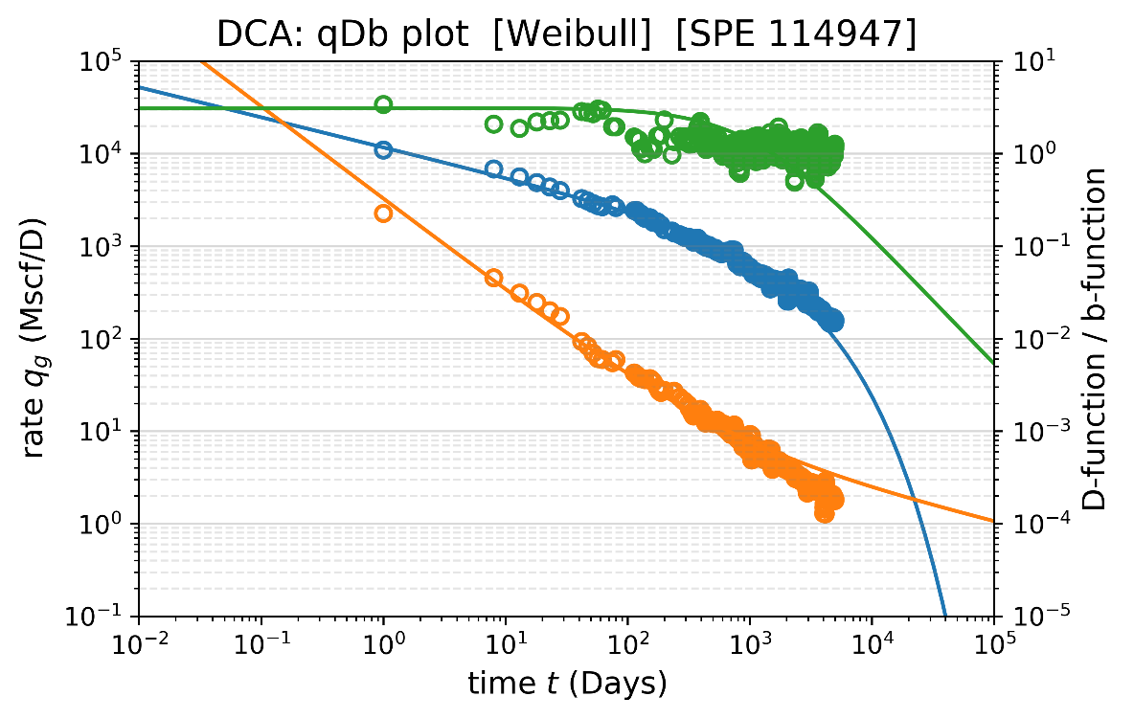

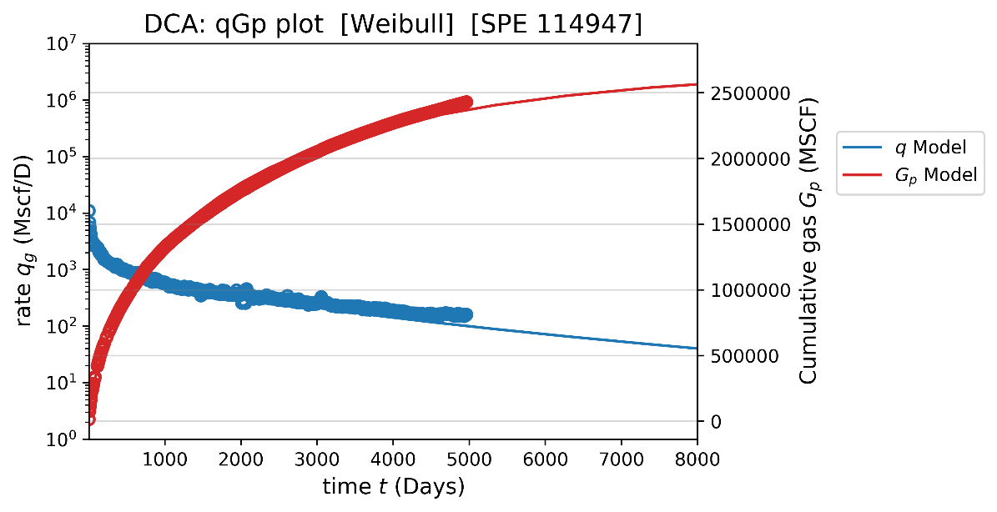
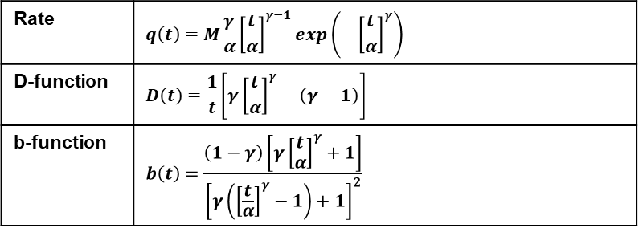
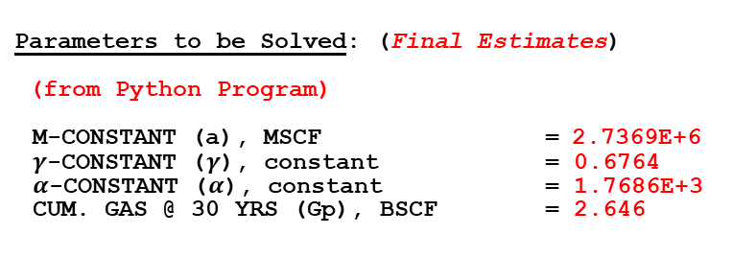
DCA model: Weibull model (SPE 161092)
Equation box:
Parameters to be Solved: (Final Estimates)
(from Python Program)
M-CONSTANT (a), MSCF = 2.7369E+6
$γ$-CONSTANT ($γ$), constant = 0.6764
$α$-CONSTANT ($α$), constant = 1.7686E+3
CUM. GAS @ 30 YRS (Gp), BSCF = 2.646
Rate | $$q\left(t\right)=M\frac{γ}{α}{\left[\frac{t}{α}\right]}^{γ−1}exp\left(−{\left[\frac{t}{α}\right]}^{γ}\right)$$
D-function | $$D\left(t\right)=\frac{1}{t}\left[γ{\left[\frac{t}{α}\right]}^{γ}−\left(γ−1\right)\right]$$
b-function | $$b\left(t\right)=\frac{\left(1−γ\right)\left[γ{\left[\frac{t}{α}\right]}^{γ}+1\right]}{{\left[γ\left({\left[\frac{t}{α}\right]}^{γ}−1\right)+1\right]}^{2}}$$
Comment:
This model is the most conservative decline curve model and yields the least cumulative production at 2.65 BSCF.
The flow rate is underestimated during the late time, and the decline constant (D) is overestimated during the late time as well. The overall match is acceptable

Slide 7
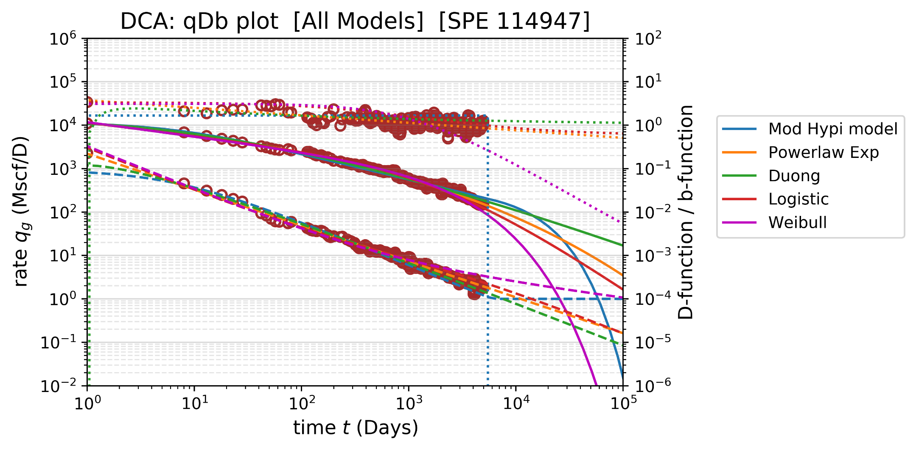



DCA model: All models
$$b$$
$$q_{g}$$
$$D$$
Cumulative production @ 30 years:
(from optimistic to conservative)
Modified hyperbolic = 3.42 BSCF
Duong’s model = 3.24 BSCF
Power-law exponential = 3.01 BSCF
Logistic model = 2.82 BSCF
Weibull model = 2.65 BSCF

Slide 8
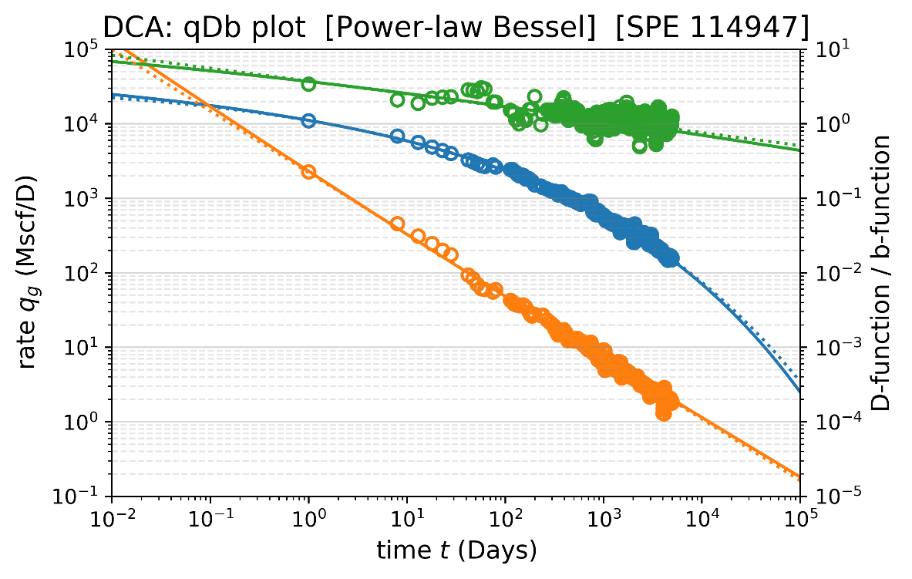
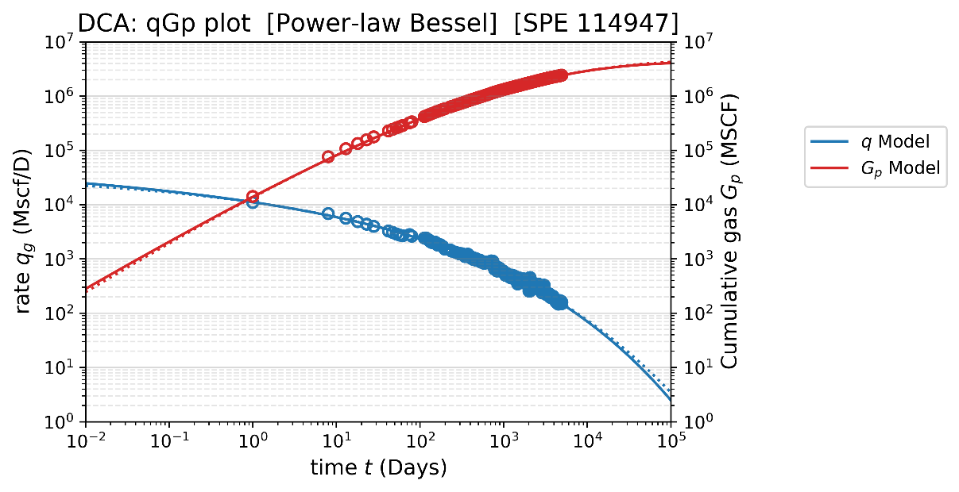
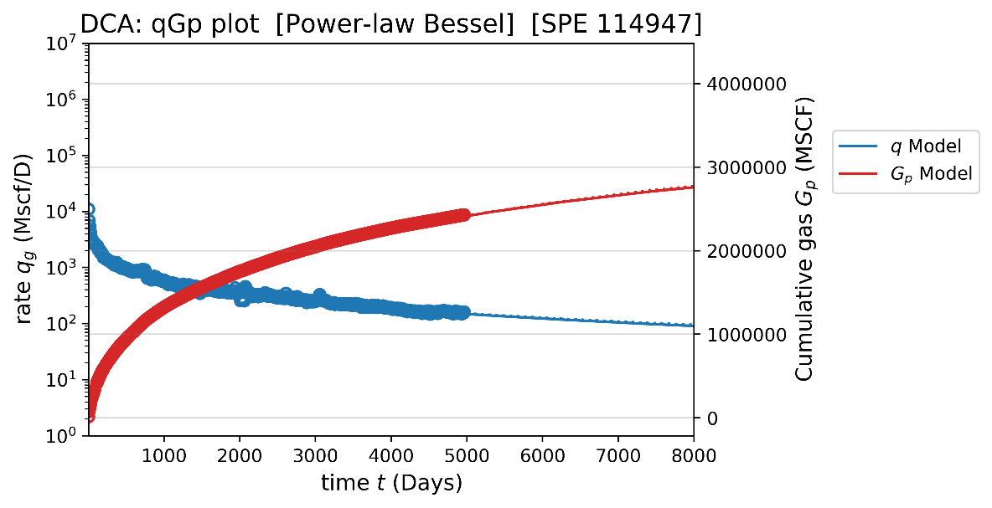
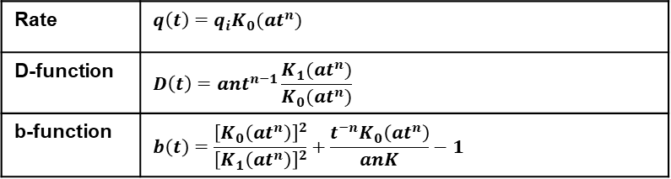
DCA model: [NEW model] Power-law Bessel – by K.P.
Equation box:
Parameters to be Solved: (Final Estimates)
(from Python Program)
INITIAL RATE (qi), MSCF/D = 15985
a-CONSTANT (a), constant = 0.6664
n-CONSTANT (n), constant = 0.2152
CUM. GAS @ 30 YRS (Gp), BSCF = 2.978
Rate | $$q\left(t\right)=q_{i}K_{0}(at^{n})$$
D-function | $$D\left(t\right)=ant^{n−1}\frac{K_{1}(at^{n})}{K_{0}(at^{n})}$$
b-function | $$b\left(t\right)=\frac{{\left[K_{0}\left(at^{n}\right)\right]}^{2}}{{\left[K_{1}\left(at^{n}\right)\right]}^{2}}+\frac{t^{−n}K_{0}\left(at^{n}\right)}{anK}−1$$
This model is slightly conservative than power-law exponential: (lower q + higher D toward the end)
(Solid line = Power-law Bessel, dash line = Power-law Exp.)
Comment:
This model is the “near-twin” of power-law exponential model. The predicted cumulative production at 30 years = 2.978 MSCF, which is very close to that from power-law exp. (3.005 MSCF)
This empirical model is derived on the radial flow equation when K0(x) can be approximated to be ln(x) and the constant rate solution will be approximately the reciprocal of pressure solution.

